Slide 1

Eugenie Jones
More than I imagine, and…

Slide 2
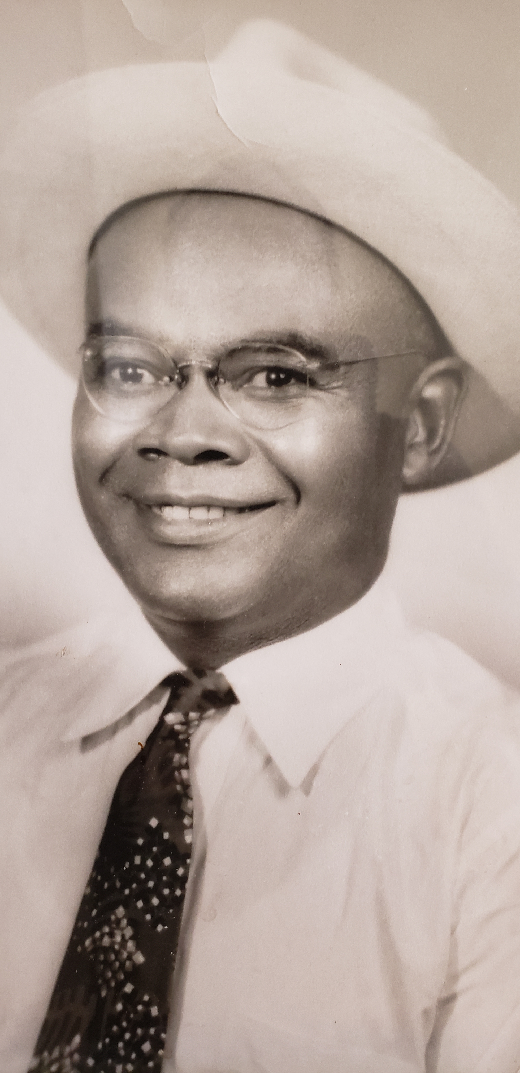
Beginnings
Graduate Mother Writer Singer/Songwriter
Entrepreneur Producer Marketing Expert
Community Relations Fitness Guru

Slide 3
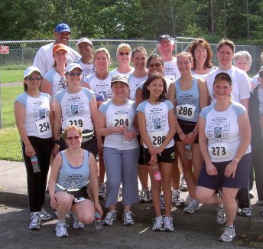

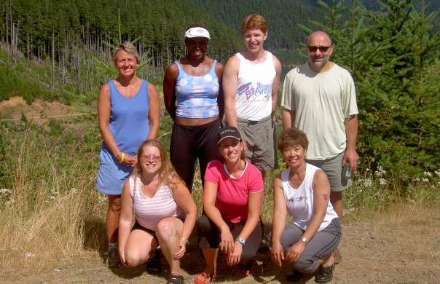
Fitness Teaching Writing

Slide 4
Fitness Teaching Writing
Kitsap Sun
US Navy
LifeWork Training

Slide 5



Enters Music

Slide 6
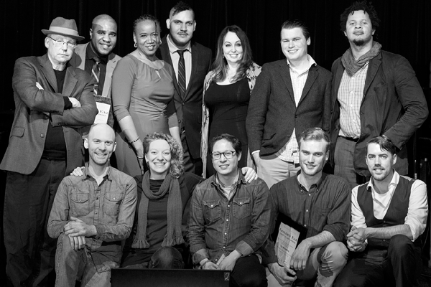
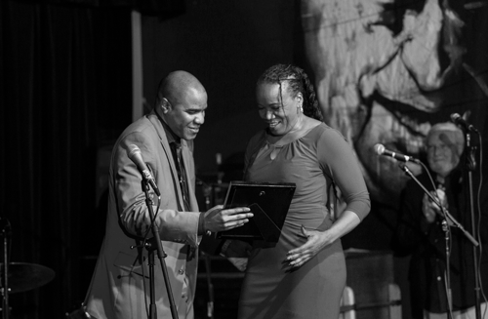
Recording Artist
Earshot Jazz Awards
Jazz Week Review

Slide 7


Beginnings
PRODUCING
SOLD OUT

Slide 8

Atlanta San Jose Washington, DC DENVER Texas New Orleans

Slide 9

